Slide 1
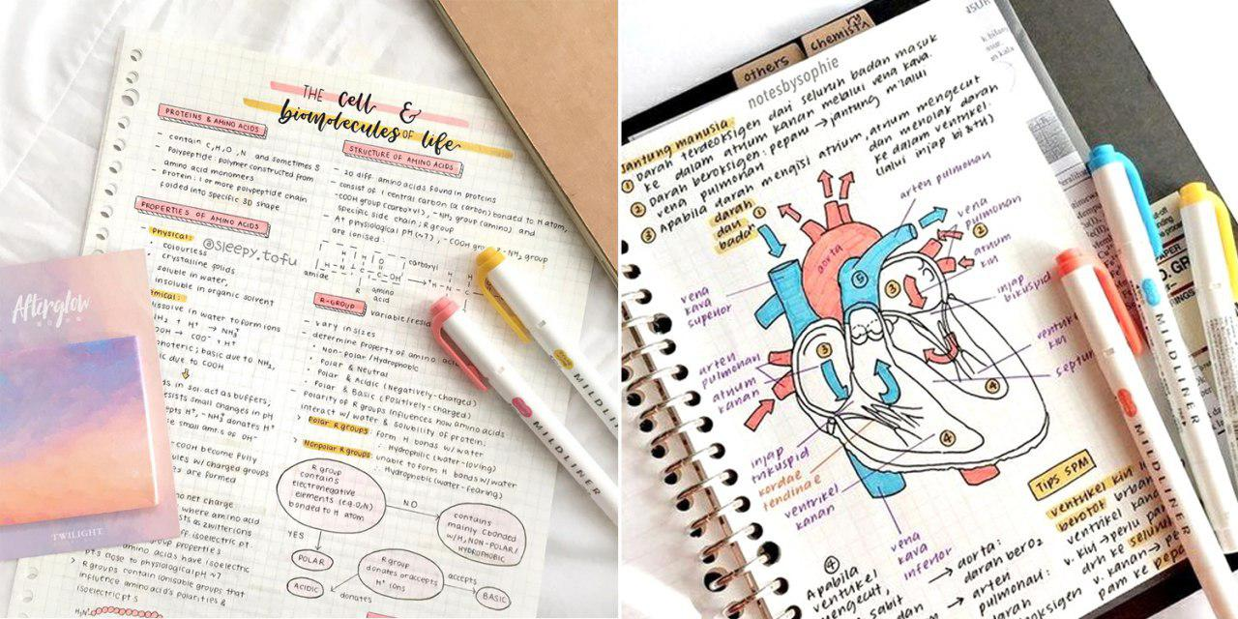
STUDY NOTES SHARING SITE

Slide 2

ABC UNIVERSITY
Guided By: Presented By:
Prof. AAAAAAAAAAA BBBBBBBBB

Slide 3

DEVELOPER
BBBBBBBBB
CCCCCCCCCC

Slide 4
ABSTRACT
INTRODUCTION:
In this project “Notes Sharing Site Project” student and faculty can upload/download engineering subject notes. Through the notes sharing process, users can upload, download and also view the study notes uploaded by others. User can also edit the notes uploaded by him. In this project two major modules that have been provided are administrator module and user module.

Slide 5
Introduction
The several features that are provided by this project are that the users can upload and download the study notes. However the users do not have authority to delete the records of the website. This authority vests only with the administrator. It is also a secure and easy to use process. Also, in recent days, there has been a lot of demand for multimedia notes.

Slide 6
DESCRIPTION
In the project Notes Sharing Site - Php Mysql project, if any user as to upload any multimedia notes, he can do so by registering himself in the registration link. The entire system described here is totally computerized which negates all the drawbacks of the previous system. In the design process, a blue print is provided for the implementation, testing and maintenance is provided.
After the software is implemented then it is very essential to test the software. It’s basically a trial to know if the software is best. The software testing includes different kinds of testing. They are unit testing, integration testing, system testing, acceptance testing, white box testing and black box testing. Once the testing is executed, the results are compared with the expected results.

Slide 7
3. SCOPE & PURPOSE
3.1 PURPOSE:
All users can upload and share study notes with other users.
Users can select the stream (branch) at the time of upload.
User can upload notes in the pdf, doc, ppt, zip, txt etc. file format.
User can search notes via branch, subject and title.
Administrator or management can manage the users and notes.
Admin can accept or reject the notes uploaded request. Notes can published only after accepted by admin.

Slide 8
Existing System:
In present situation in any user share files via social networking site like facebook , whatsapp or via gmail. To avoid using social networking sites our software help user to easily share files with our friends and also search notes by its title , subject and branch.

Slide 9
PROPOSED SYSTEM:
The main aim of the project is to user can share notes easily in the web.
In this System, notes uploading ,searching and downloading is possible.
User can login from any location and upload notes and download multimedia notes uploaded by other users.

Slide 10
Project Analysis:
This application has been divided in to two modules
User Module
Admin Module

Slide 11
User Modules:
Upload Notes
Search Notes Via stream , title and subject
Download Notes
Delete and update our Notes
Change Password

Slide 12
Admin Modules:
Manage(View/Delete) Users
Manage(View/Delete) Notes
Accept or Reject Notes
Change Password

Slide 13
SCOPE:
The project has a wide scope, as it is not intended to a particular organization. This project is going to develop generic software, which can be applied by any businesses organization. More over it provides facility to its users. Also the software is going to provide a huge amount of summary data.

Slide 14
SOFTWARE USED
PYTHON INTERPRETER
PYCHARM IDE (INTEGRATED DEVELOPMENT ENVIRONMENT)
DJANGO FRAMEWORK
NOTEPAD++ OR ANY OTHER TEXT EDITOR
CHROME OR ANY OTHER BROWSER

Slide 15
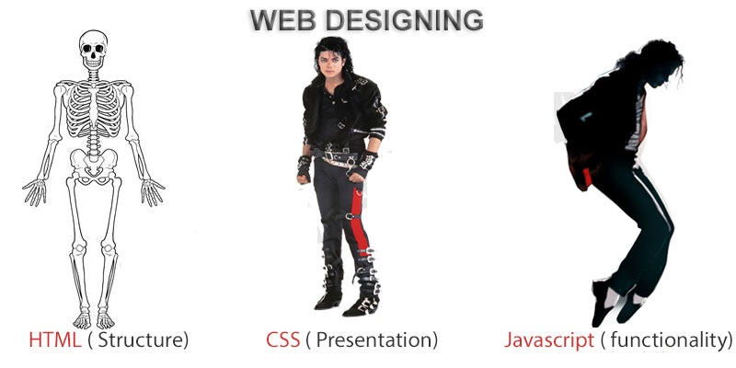
FRONTEND (LANGUAGE USED)
HTML (HYPERTEXT MARKUP LANGUAGE)
CSS (CASCADING STYLE SHEET)
BOOTSTRAP (FRAMEWORK OF CSS AND JS)

Slide 16

BACKEND
PYTHON DJANGO
SQLITE (DATABASE)

Slide 17
SYSTEM DESIGN
Unified Modeling Language:
UML stands for Unified Modeling Language. It is a third generation method for specifying, visualizing and documenting the artifacts of an object oriented system under development. Object modeling is the process by which the logical objects in the real world (problem space) are represented (mapped) by the actual objects in the program (logical or a mini world). This visual representation of the objects, their relationships and their structures is for the ease of understanding. This is a step while developing any product after analysis.

Slide 18
The Unified Modeling Language encompasses a number of models.
Use case diagrams
Class diagrams
Sequence diagrams

Slide 19
Use Case Diagram:
Use case diagram consists of use cases and actors and shows the interaction between them. The key points are:
The main purpose is to show the interaction between the use cases and the actor.
To represent the system requirement from user’s perspective.
The use cases are the functions that are to be performed in the module.
An actor could be the end-user of the system or an external system.

Slide 20
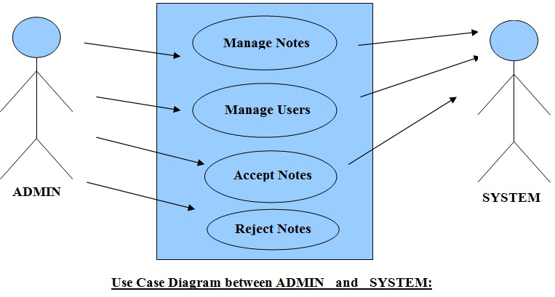

Slide 21
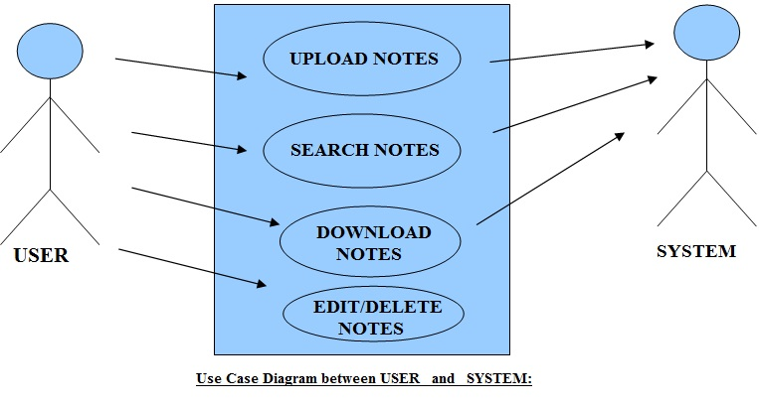

Slide 22
Sequence Diagram:
The purpose of sequence diagram is to show the flow of functionality through a use case. In other words, we call it a mapping process in terms of data transfers from the actor through the corresponding objects.

Slide 23
SEQUENCE DIAGRAM

Slide 24
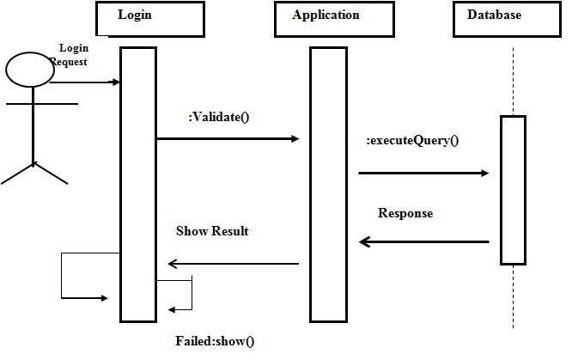
Sequence Diagram For Administrator:-

Slide 25
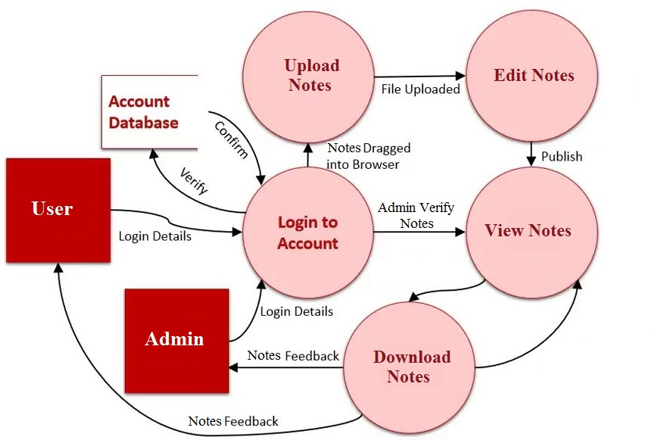
Data Flow Diagram(DFD) Context Level DFD

Slide 26
ER Diagram

Slide 27
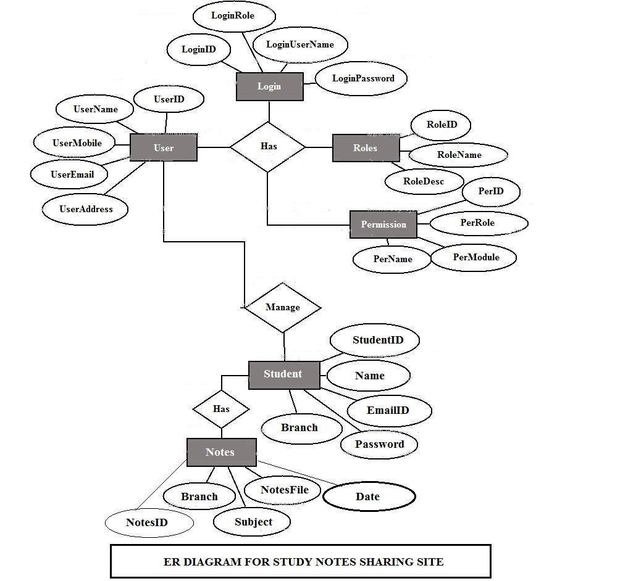

Slide 28
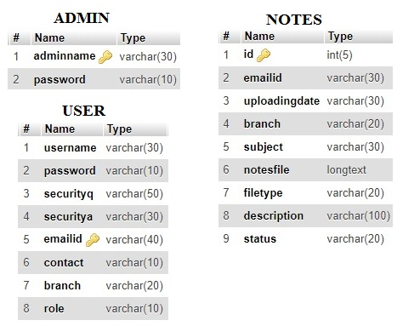
Database Tables

Slide 29
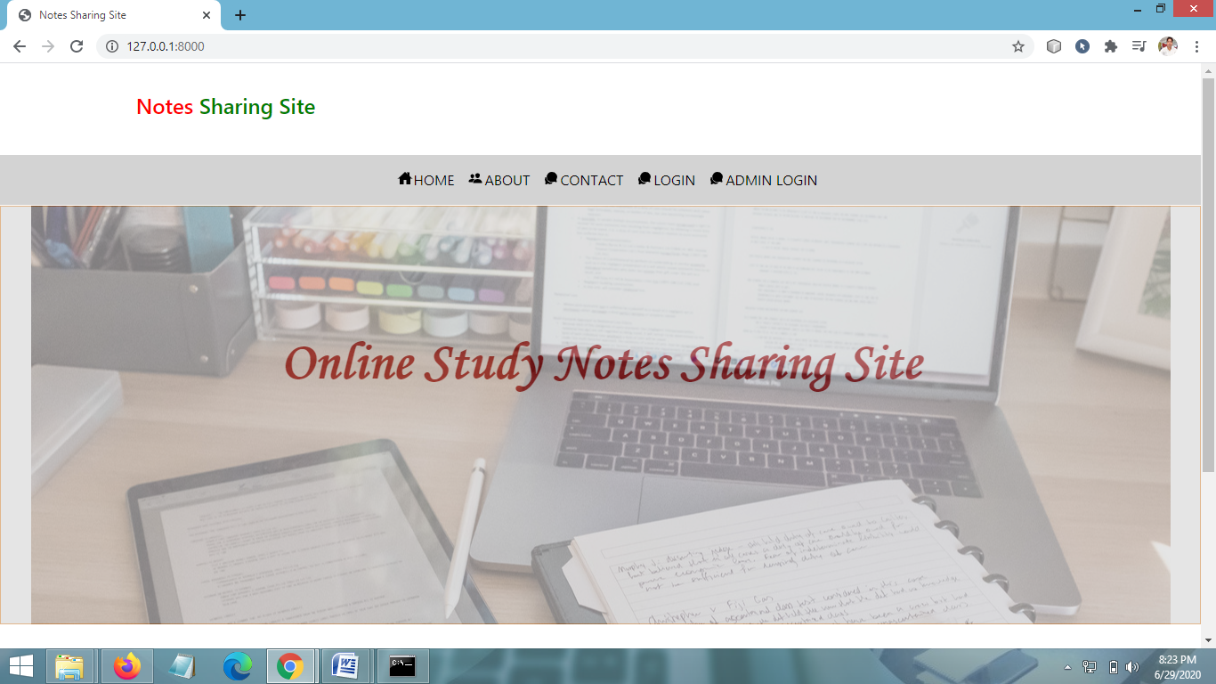
SCREEN SHOTS Home Page

Slide 30
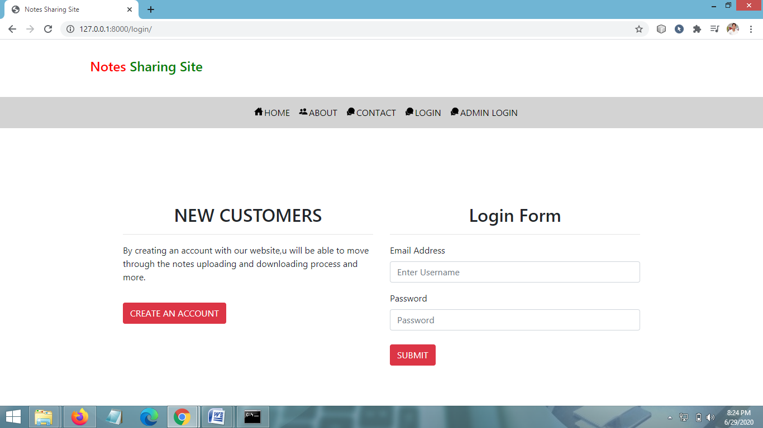
User Login Page

Slide 31
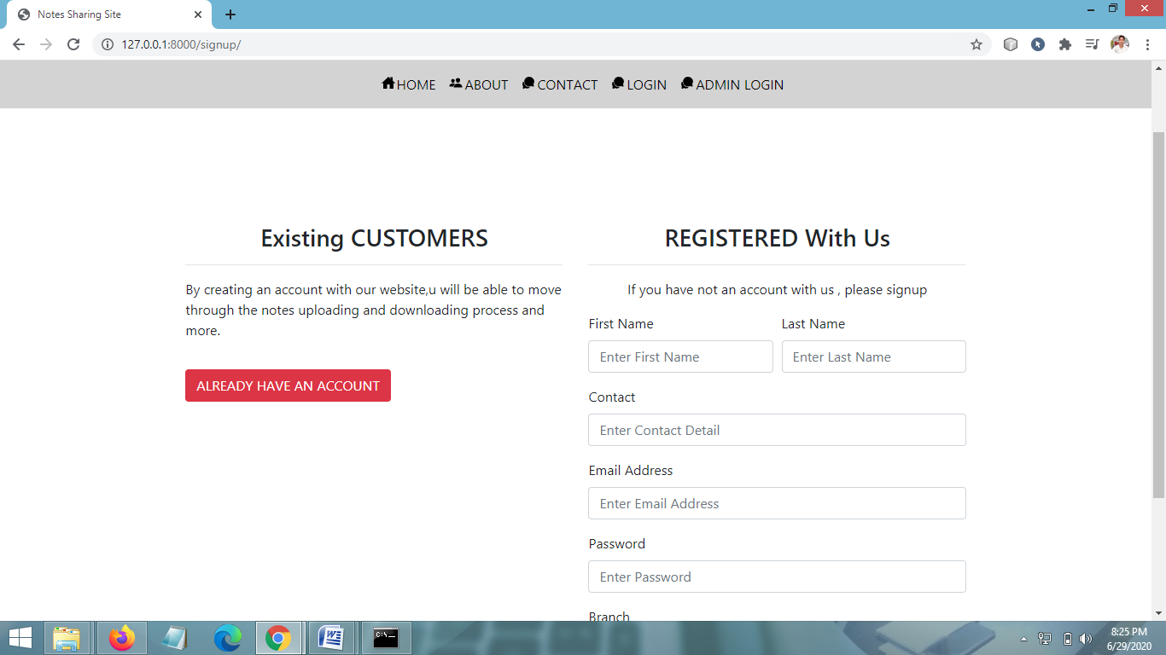
SIGNUP PAGE

Slide 32
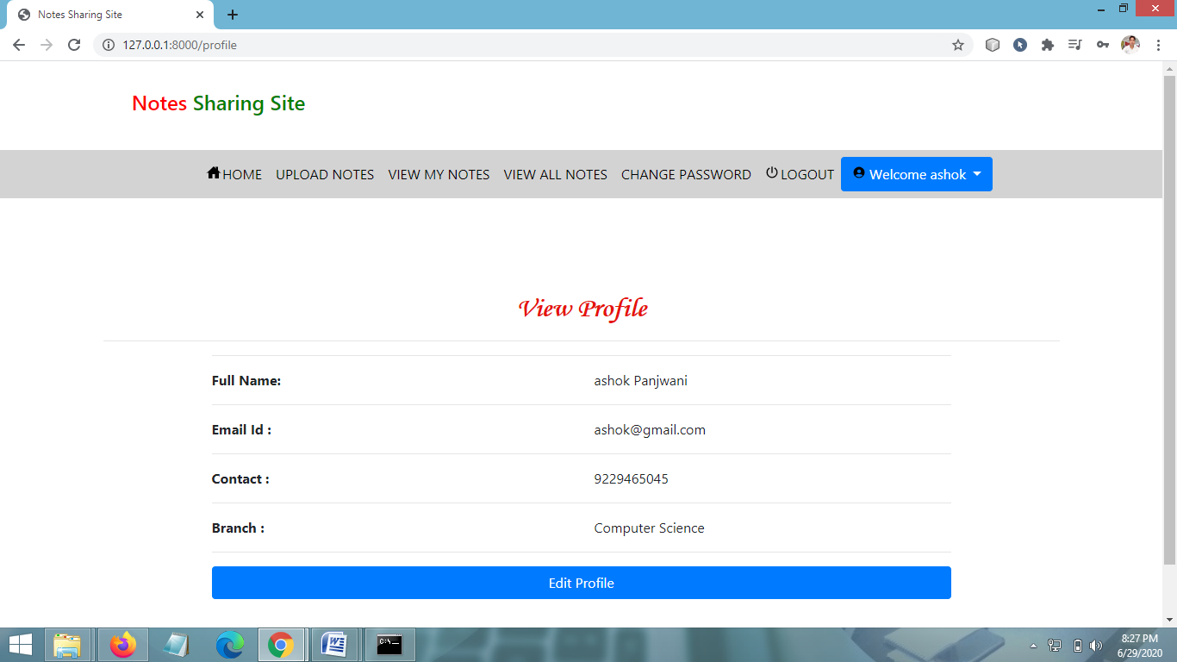
USER PROFILE PAGE

Slide 33
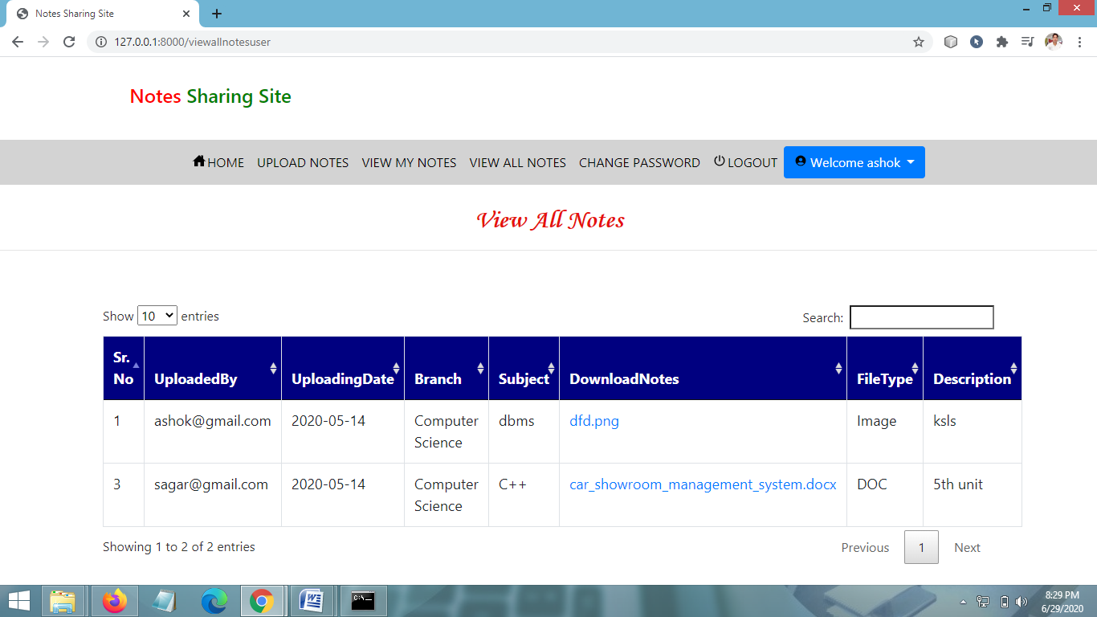
VIEW ALL NOTES PAGE

Slide 34
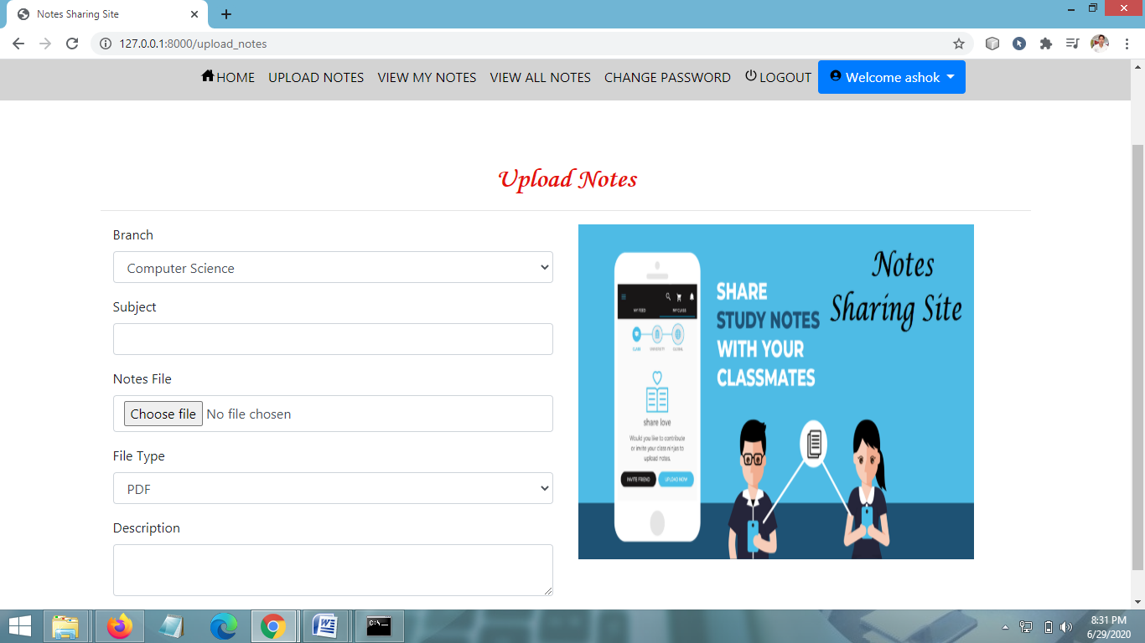
UPLOAD NOTES PAGE

Slide 35
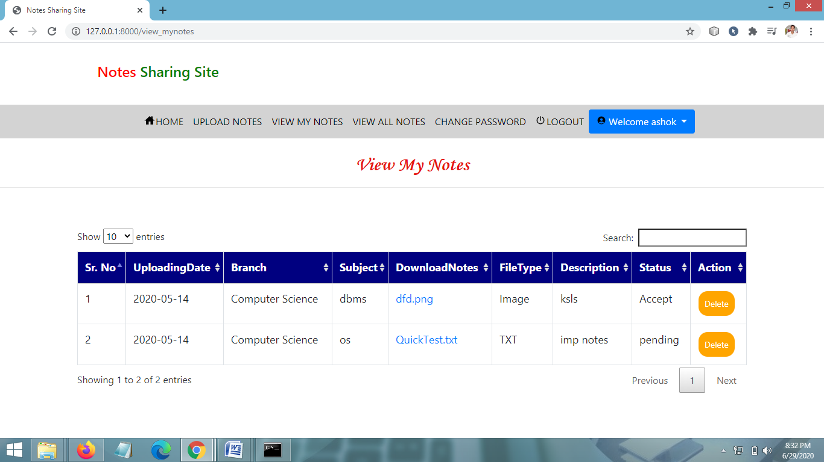
VIEW MY NOTES PAGE

Slide 36
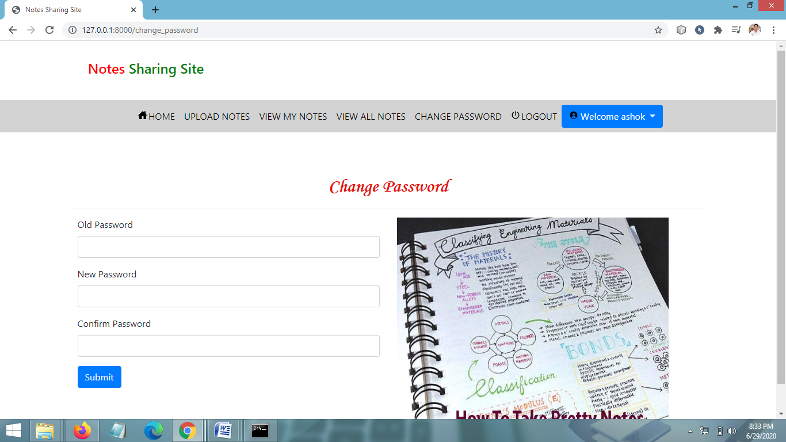
CHANGE PASSWORD PAGE

Slide 37
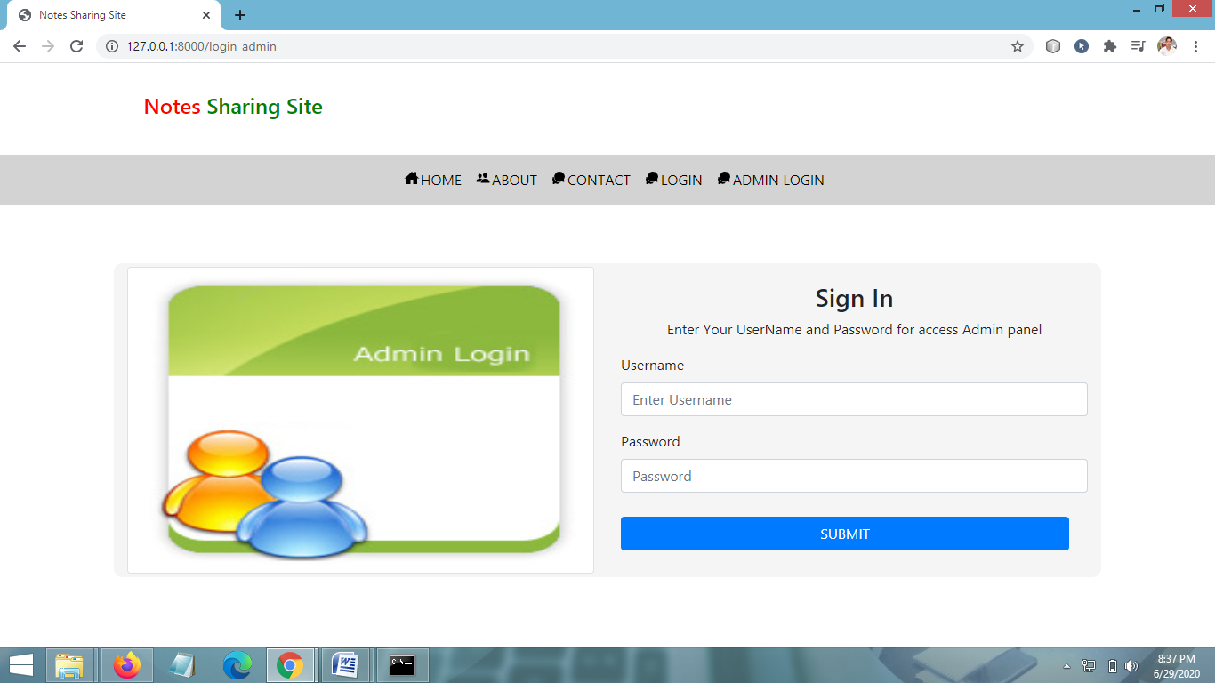
ADMIN LOGIN PAGE

Slide 38
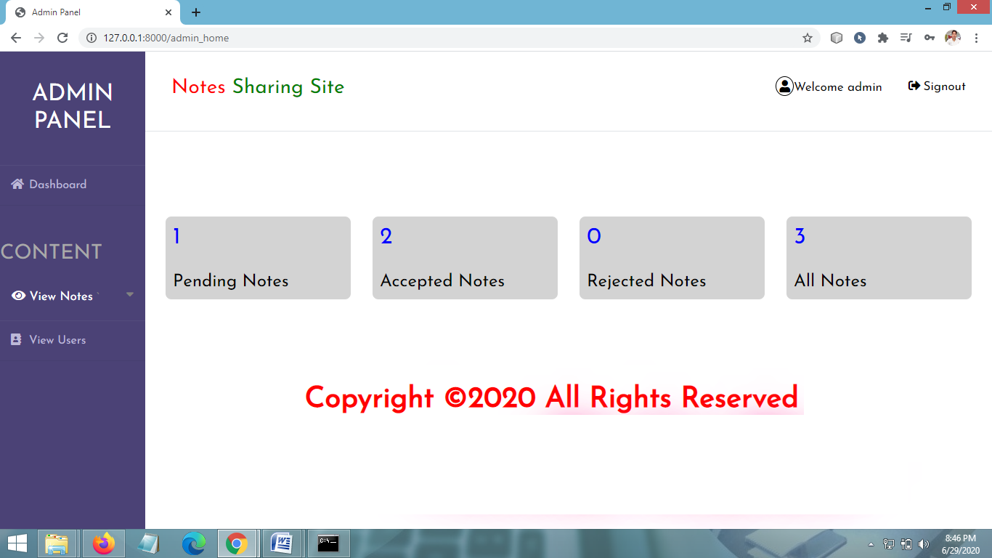
ADMIN HOME PAGE

Slide 39
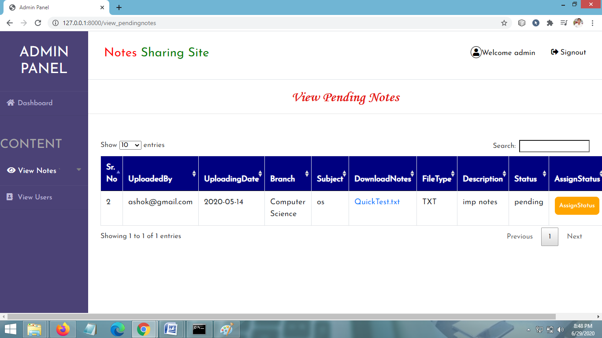
NOTES UPLOAD REQUEST PAGE

Slide 40
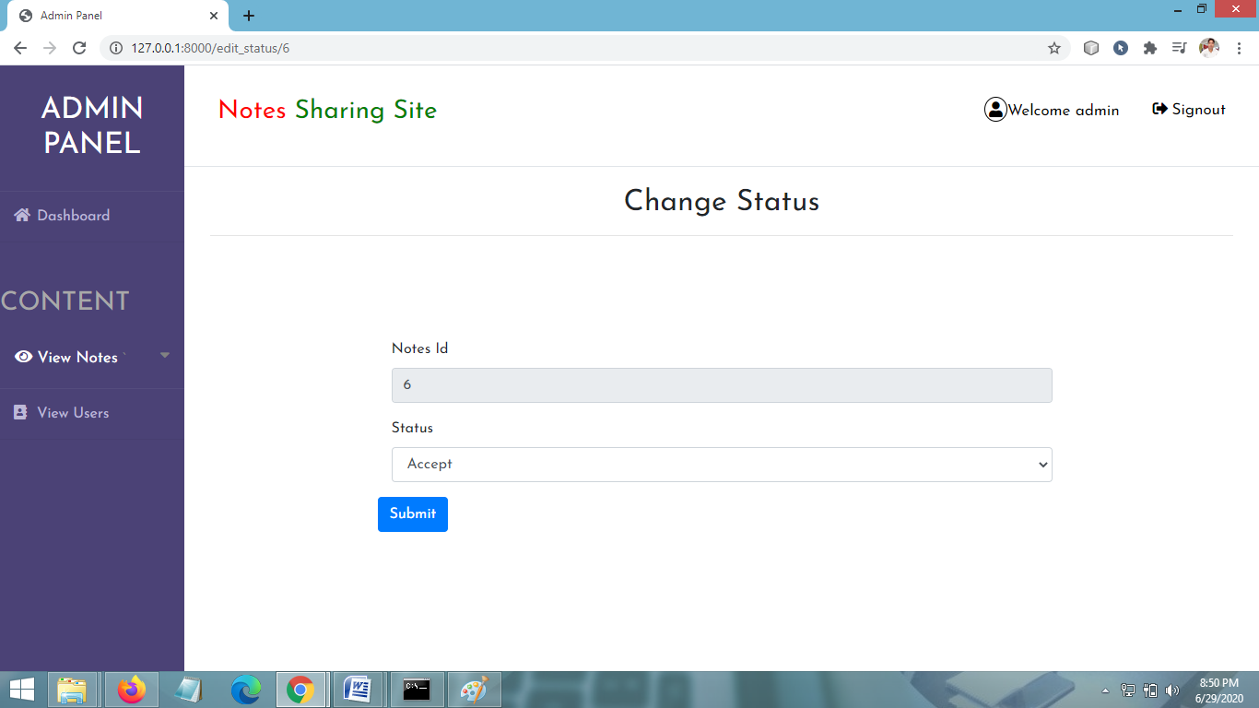
NOTES ACCEPT/REJECT PAGE

Slide 41
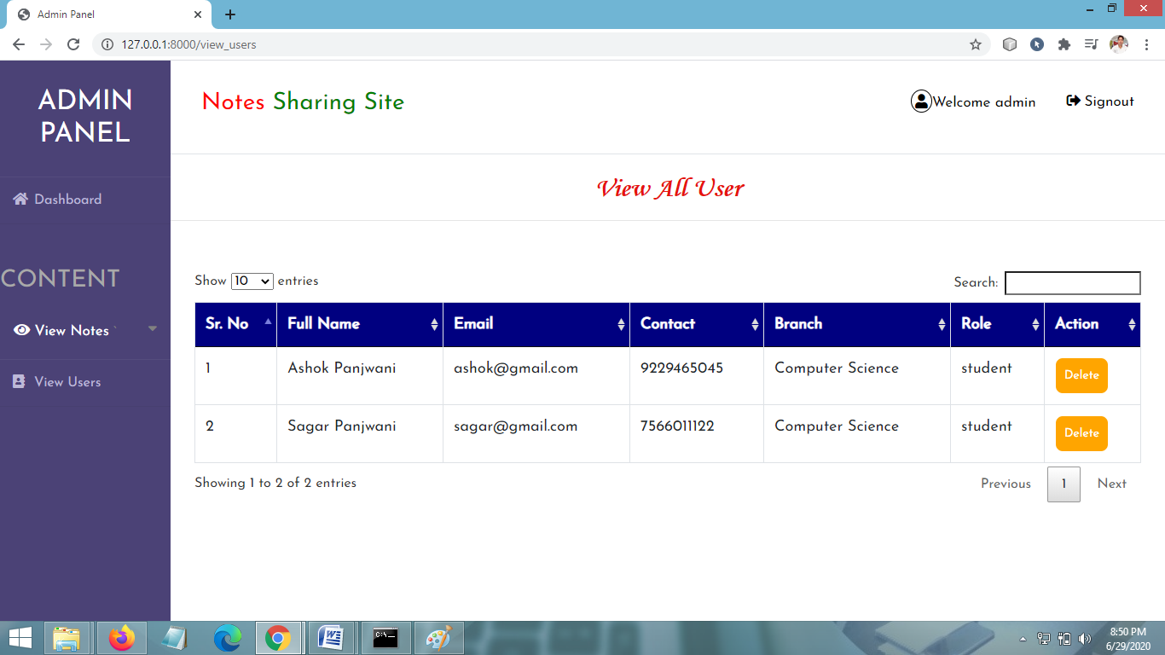
VIEW ALL USERS PAGE

Slide 42
CONCLUSION & FUTURE SCOPE
FUTURE SCOPE
This web application involves almost all the features of the online file sharing. The future implementation will be online help for the users and chatting with website administrator.
CONCLUSION
This project has several advantages. Managing the levels of the project is pretty easy and so is storing the notes. It is easy to maintain up to date information and is cheaper to maintain. Also, manual tracking is not required.

Slide 43
BIBLIOGRAPHY
FOR PYTHON INSTALLATION
https://www.python.org
FOR HTML , CSS ANF PYTHON BASICS
www.w3schools.com
www.javatpoint.com
https://www.geeksforgeeks.org/python-django/
REFERENCE BOOKS
Two scoops of Django for 1.11 by Daniel Greenfeld’s and Audrey Greenfield
Lightweight Django by Elman and Mark Lavin

Slide 44
THANKYOU

